Slide 1
Dapr Distributed Application Runtime
.NET Community Meetup #44
July 6th, 2023
Notes:
See Gartner slides 2021-04 App Plat Dapr & Radius.pptx (sharepoint.com)

Slide 2



Speakers
Boost developer productivity by providing tools and APIs for building cloud native applications.
Mark Fussell
Alice Gibbons
Co-founder & CEO
Co-creator of Dapr project
mark@diagrid.io
Customer Success Engineer
alice@diagrid.io

Slide 3

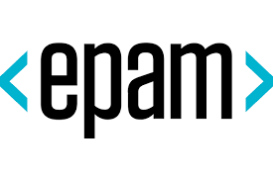
Speakers
Certified cloud solutions architect with extensive experience in a wide variety of highly scalable cloud solutions for different business domains.
Mykhaylo Stepanyak
Solution Architect
Mykhaylo Stepanyak@epam.com

Slide 4

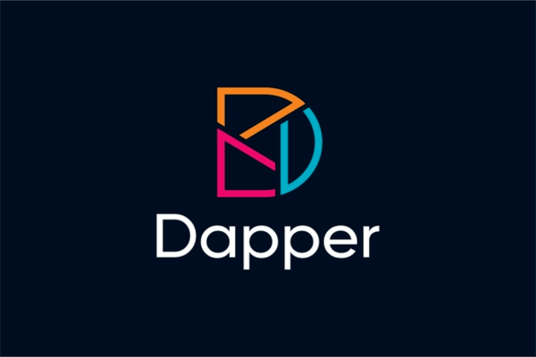
DAPR != Dapper
Distributed Application Runtime

Slide 5



Benefits of Microservice Architecture
Single Responsibilities
Fault Isolation
Smaller more specific codebase
independently deployable & scalable

Slide 6
Challenges of Microservice Architecture
Complex Communication
Debugging and integration testing
Interface Control

Slide 7
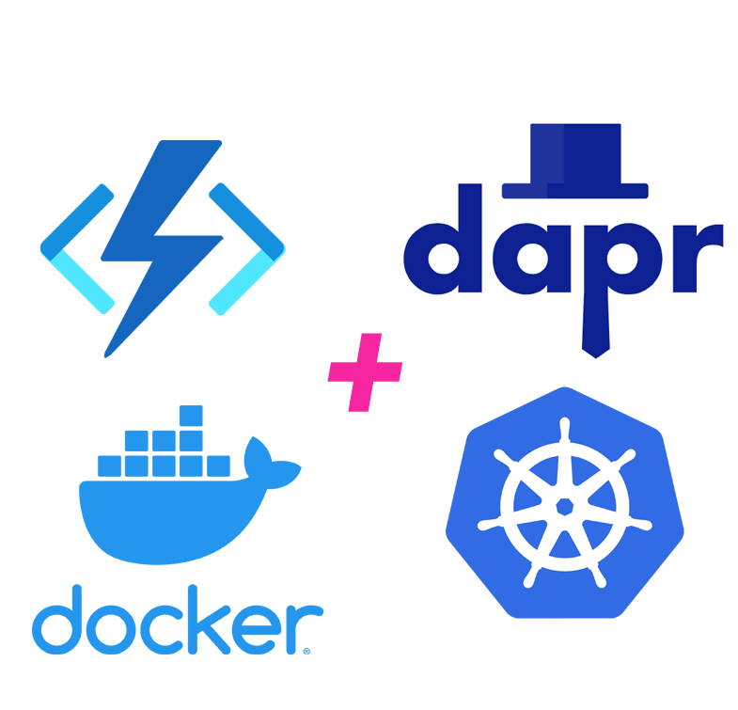
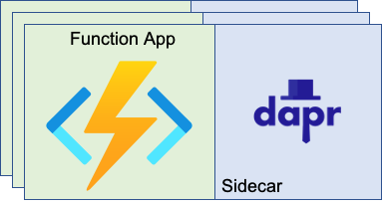
Case Study :: Dapr and Azure Functions
Demo:

Slide 8






Developer
challenges
E-commerce app
How do I send messages to many applications?
How do I implement first-write-wins?
Inventory
How do I expire sent messages?
How do I handle state conflicts from multiple apps?
How do I measure latency on my database?
I just want to trace my calls end–to-end. What’s OpenTelemetry?
I just want to trace my calls end–to-end. What’s OpenTelemetry?
Email
Payment
RCMD
How do I secure access to my data layer?
Frontend
Cart
Checkout
State
Management
Internet
How to I handle failed calls and perform retries?
How do I encrypt calls with ongoing cert rotation?
Shipping
Queue
How do applications discover and call each other?

Slide 9
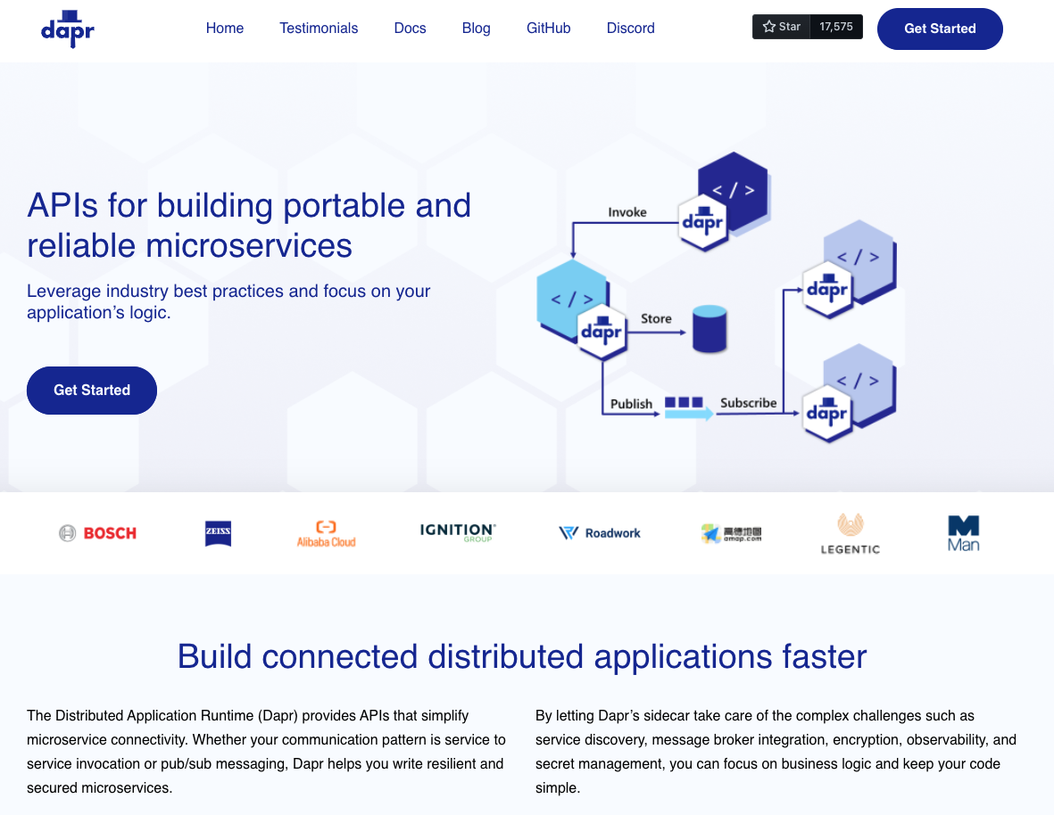
Distributed Application Runtime
Portable, event-driven, runtime for building distributed applications across cloud and edge
dapr.io

Slide 10
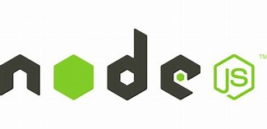

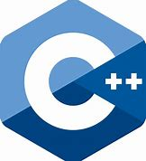






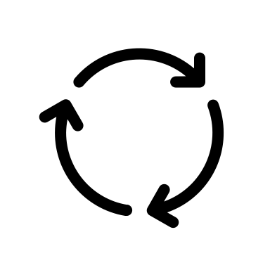
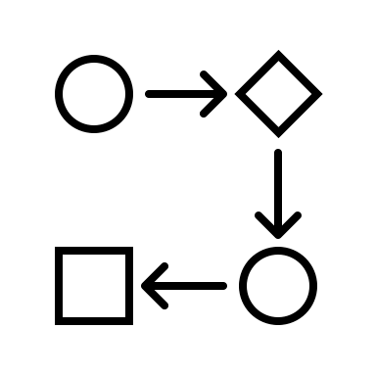




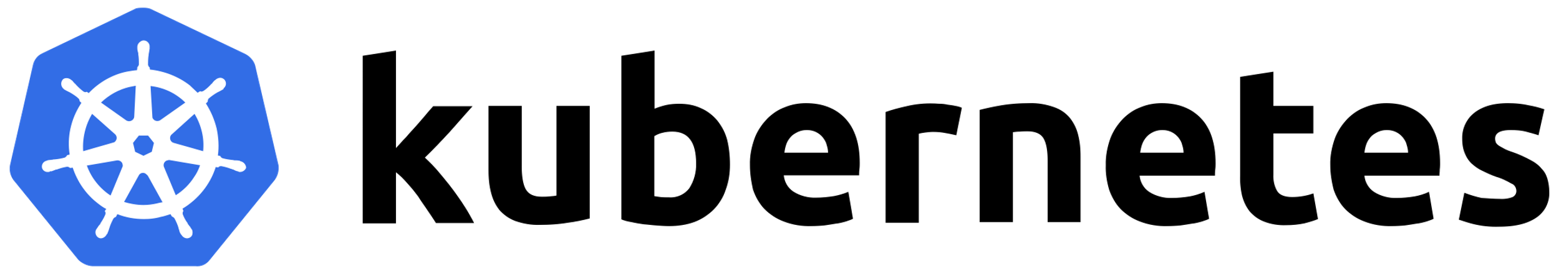
Dapr APIs
Application code
Microservices written in
Microservices written in
Any code or framework…
HTTP API
gRPC API
Service-to-service invocation
State management
Publish and subscribe
Resource bindings and triggers
Actors
Observability
Secrets
Configuration
Distributed Lock
Workflow
Any cloud or edge infrastructure
virtual or
physical machines

Slide 11
Dapr Goals
Best-practices building blocks
Any language or framework
Consistent, portable, open APIs
Adopt standards
Extensible and pluggable components
Platform agnostic cloud + edge
Community driven, vendor neutral

Slide 12
Sidecar model
Application
Dapr sidecar
My App
Dapr API
HTTP/gRPC
POST http://localhost:3500/v1.0/invoke/cart/method/order
GET http://localhost:3500/v1.0/state/inventory/item67
POST http://localhost:3500/v1.0/publish/order
GET http://localhost:3500/v1.0/secrets/vault/password42
GET http://localhost:3500/v1.0-alpha1/workflows/dapr/businessprocess/1234/start

Slide 13























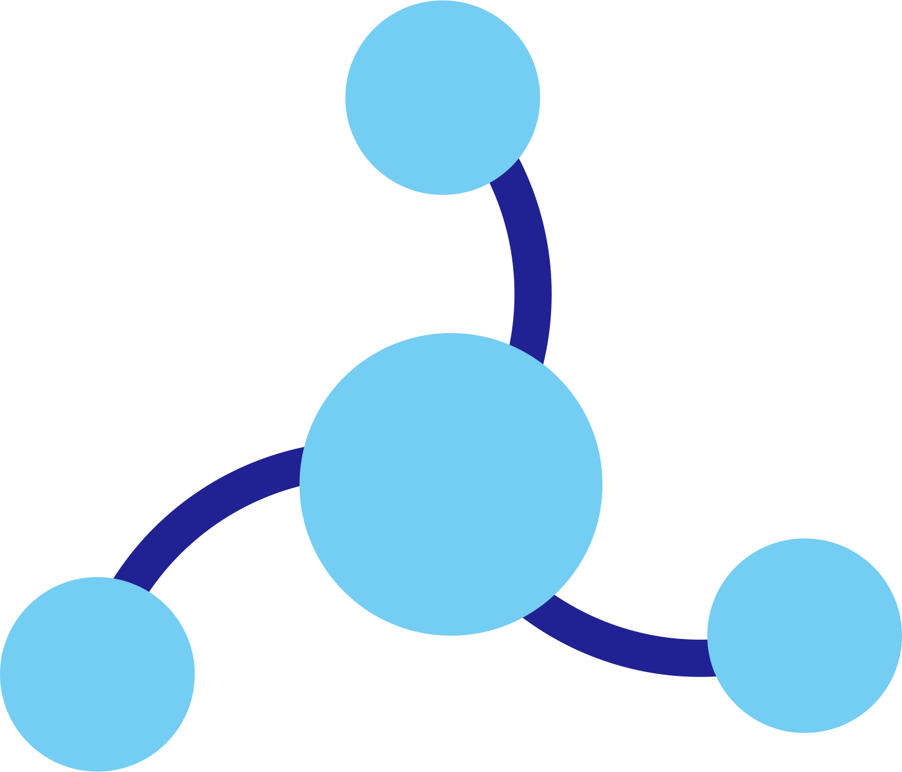




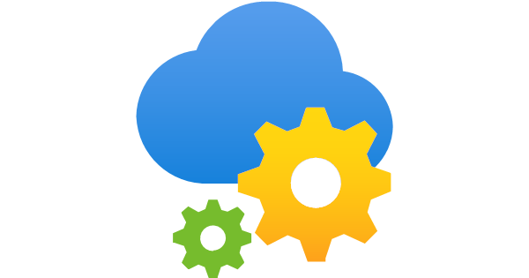


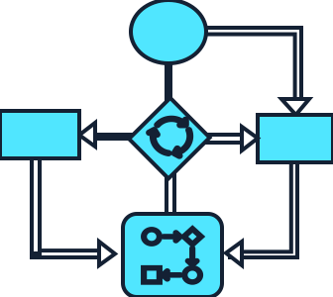

Dapr components
State
Stores
AWS
DynamoDB
Azure
CosmosDB
Firebase
Redis
Cassandra
Pub/sub
Brokers
AWS
SQS
Azure
Service Bus
GCP
Pub/Sub
Redis
Bindings
& Triggers
AWS
S3
Azure
Storage
GCP
Storage
Twilio
Kafka
App
Secret
Stores
AWS
Secrets Manager
Azure
KeyVault
GCP
Secret Manager
HashiCorp
Vault
Kubernetes
Secret
Observability
Prometheus
AppInsights
Zipkin
Jaeger
Configuration
Redis
Azure
App Config
PostgreSQL
Distributed
Lock
Over 115 components available
Redis
Workflow
Dapr Workflow
Actors
Redis
AWS
DynamoDB
Azure
CosmosDB
MongoDB
PostgreSQL

Slide 14


Pluggable components
Pub/sub broker
Secret store
Notes:
[1/12] File icon

Slide 15

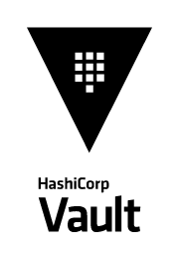
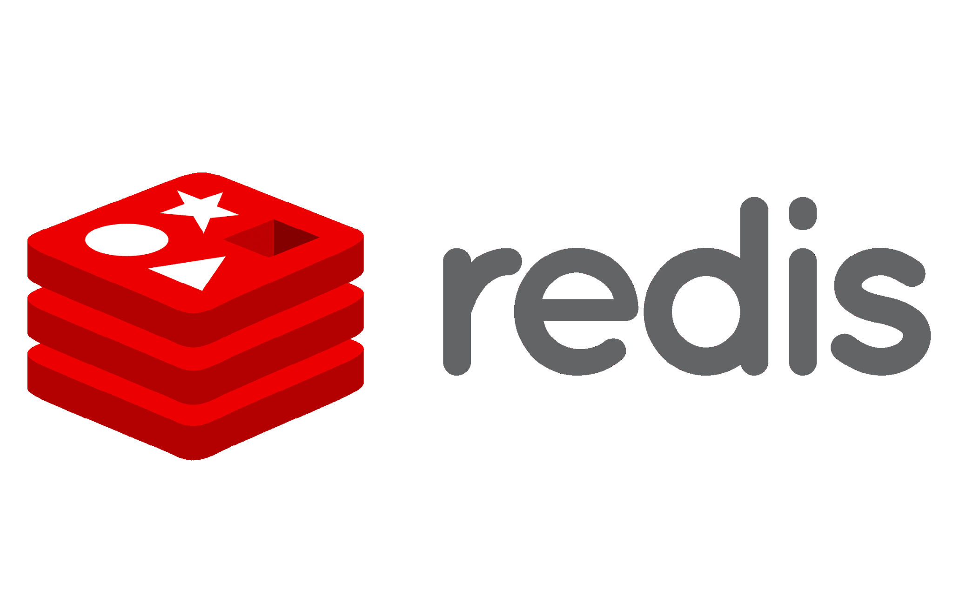
Pluggable components
+
On-prem
Notes:
[1/12] File icon

Slide 16



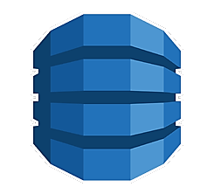
Pluggable components
Simple Notification Service (SNS)
+
Key Management Service (KMS)
DynamoDB

Slide 17




Pluggable components
Azure Service Bus
+
Azure Key Vault
Azure Cosmos DB

Slide 18






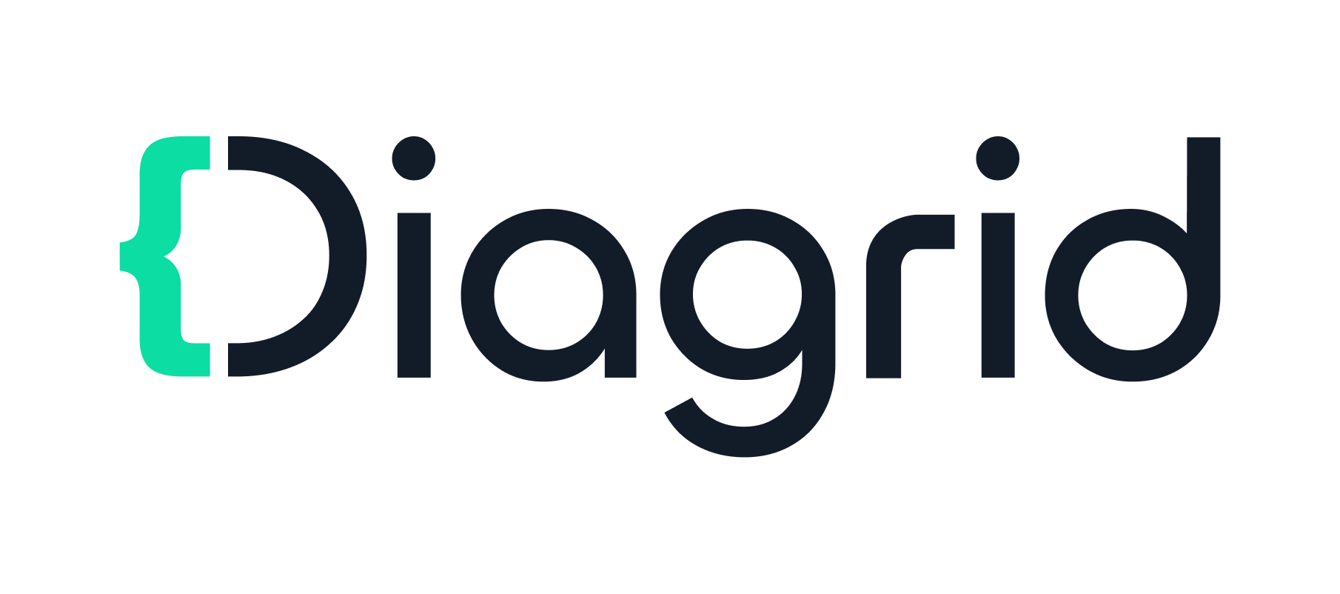





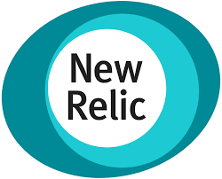
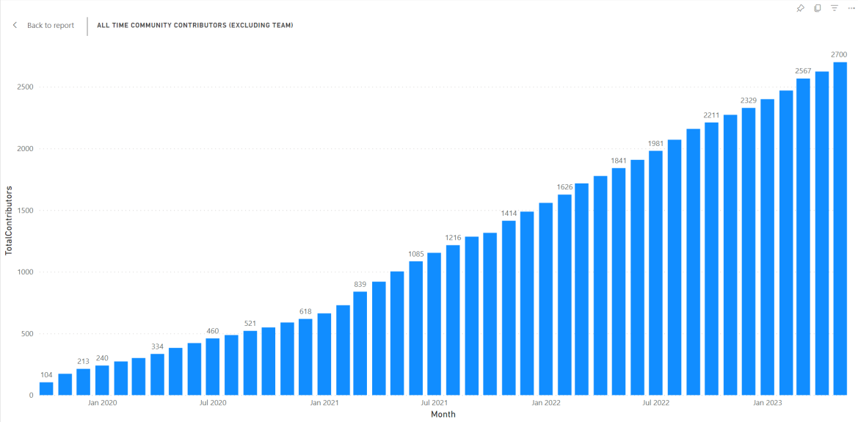


Dapr Community momentum
Contributing organizations include:
21.5k
GitHub stars
2.8k
Contributors
117
Community
components
1.0M+
Monthly image pulls
6k
Discord members
304k
Unique docs views/mo
10/157
Largest CNCF project
3-year contributor growth

Slide 19








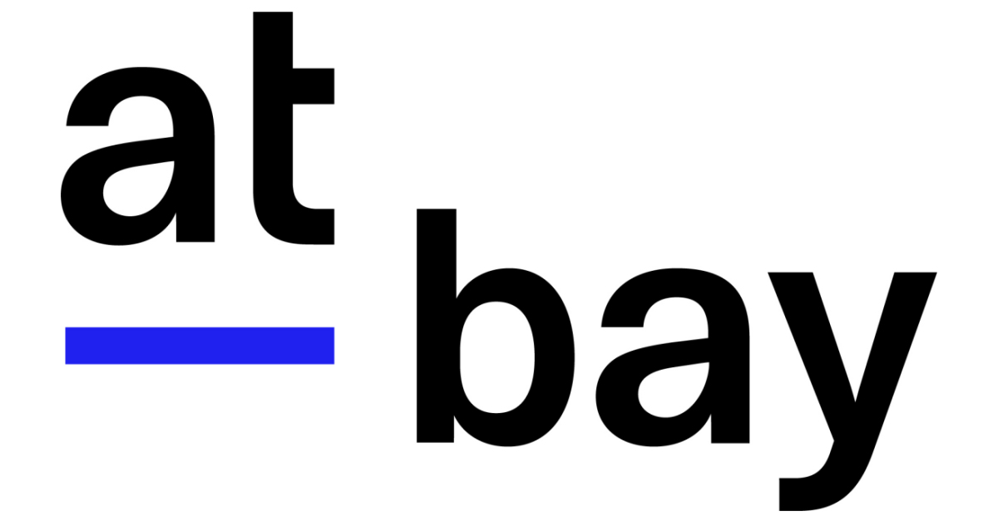




Dapr users
Notes:
https://www.cncf.io/case-studies/at-bay/

Slide 20

Dapr building blocks
Service-to- service invocation
State management
Publish and subscribe
Bindings
(input/output)
Actors
Observability
Secrets
Configuration
Distributed Lock
Workflows
Perform direct, secure, service-to-service method calls
Create long running, stateless and stateful services
Secure, scalable messaging between services
Input and output bindings to external resources including databases and queues
Encapsulate code and data in reusable actor objects as a common microservices design pattern
See and measure the message calls across components and networked services
Securely access secrets from your application
Access application configuration and be notified of updates
Mutually exclusive access to shared resources
Automate and orchestrate tasks within your application
Notes:
Over 10 Dapr building block APIs are available today that you can access through your apps.
APIs for everything from saving key values in a state store to using an actor model from within your apps. Im not going to go through all these building blocks today but I wanted to call out that Dapr recently added support for the Workflows API, a way to orchestrate long running stateful business processes in your application code built in with fault tolerance and pause/resuming activity capabilities
Today we are going to focus on two most popular building block apis – service invocation and publish and subscribe.
Service invocation allows your apps to perform service discovery and method innovation calls complete with encryption, resiliency, tracing, and security layered on top’
Publish and subscribe API enables event driven communication between apps and offers at least once delivery guarantee and integrates with other 15 message brokers and queues.

Slide 21
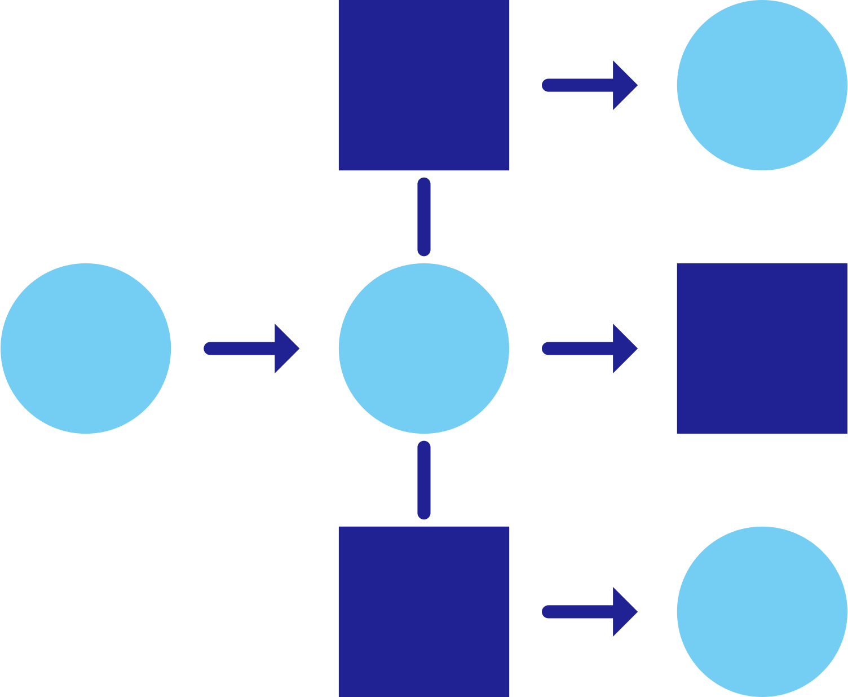

Service invocation
DNS
Name Resolution component for service discovery
(mDNS, Kubernetes DNS, Hashicorp Consul)
Checkout
Send order
Order
Processor
mTLS encryption
POST
http://localhost:3500/v1.0/invoke/orderprocessor/method/orders
POST
http://10.0.0.2:3501/orders
{"data":"order1"}
{"data":"order1"}

Slide 22

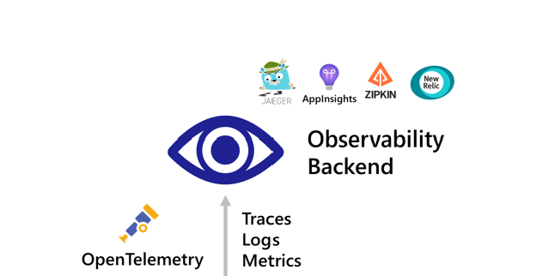





Service Invocation
HTTP/gRPC
Invoke method
CSharp
Service
React Form
mTLS encryption
POST
http://localhost:3500/v1.0/invoke/csharp-service/method/A
POST
http://10.0.0.2:3500/A
{"message": “Service invoke route A”}
{"message": “Service invoke route A”}
Notes:
So how does this work in Dapr?
Dapr has the idea of Application identities, a concept where each app has a name and permissions associated to it. Without Dapr your app needs to know the IP or domain of where the app youre trying to invoke, but with Dapr can use its app id.
We have 2 apps - react form and csharp svc
React Form makes an http/gRPC call meant for the Csharp service to the dapr svc invocation API with the route shown. The call goes to the local Dapr sidecar.
Dapr discovers Csharp services location using the name resolution component installed for the given hosting platform. - (mDNS, Kubernetes DNS, Hashicorp Consul)
Dapr forwards the message to Csharp services Dapr sidecar
Note: All calls between Dapr sidecars go over gRPC for performance. Only calls between services and Dapr sidecars are either HTTP or gRPC
This is all captured with dapr traces logs and metrics in open telemetry format - can be sent to whatever monitoring backend
Csharps services Dapr sidecar forwards the request to the specified endpoint (or method) on Csharp service – in this case method A . Csharp service then runs its business logic code in the method A.
Csharp service sends a response to React form. The response goes to Csharp services sidecar.
Dapr forwards the response to React forms Dapr sidecar.
React form receives the response.

Slide 23
Service Invocation Resiliency
1
Built-in service invocation retries are always performed with a backoff interval of 1 second up to a threshold of 3 times
React Form
CSharp
Service
1
Additional resiliency polices for `retries`, `timeouts and `circuit breakers` can be applied
Notes:
Built in resiliency with service invocation
- By default, if the service that is being called fails to respond to the calling service, the calling services dapr sidecar will retry three times with a backoff interval of 1 second
- Now this is just the default resiliency policy in dapr svc invocation however you can describe alternative policies usingDapr resiliency confirugation files and specifiy retries, circuit breakers and timeouts to the specific service calls.

Slide 24
DEMO: Dapr state management and bindings
DEMO
Service invocation

Slide 25


Publish and Subscribe
POST
http://10.0.0.2:8000/A
{"data":"Publish to topic A"}
CSharp
Subscriber
HTTP/gRPC
Redis
Cache
Python
Subscriber
React Form
POST
http://localhost:3500/v1.0/publish/pubsub/A
POST
http://10.0.0.4:8000/A
{"data":"Publish to topic A"}
{"data":"Publish to topic A"}
Notes:
How does this work:
3 apps, one publisher and 2 subscribers that we want to communicate via events.
The React form app make a gRPC or HTTP call to the Dapr pub/sub API using a route like the one here. In the route you actually specify the topic and the name of the message broker you want to publish the message on. In this case we are publishing on the “pubsub” broker on the ”A” topic
The Dapr pub/sub API makes calls into the Dapr pub/sub component that abstracts the message broker of your choice (in this case were using redis)
To receive messages, Dapr subscribes to the pub/sub component on behalf of your service to a topic and delivers the messages to an endpoint on the Python subscriber and Csharp subscriber services. In this case running the business logic in the method A
Since Dapr runs as a sidecar, the call is over localhost only, adding sub milliseconds of latency
Dapr guarantees At-Least-Once semantics for this endpoint to every subscribing service meaning that in this case both Csharp and Python subscriber are guaranteed to get a copy of the message
Dapr uses the CloudEvents 1.0 specification to adhere to a standard open source message format and too add tracing headers. Dapr automatically wraps events in a CloudEvents but they can be disabled for integration with legacy systems

Slide 26
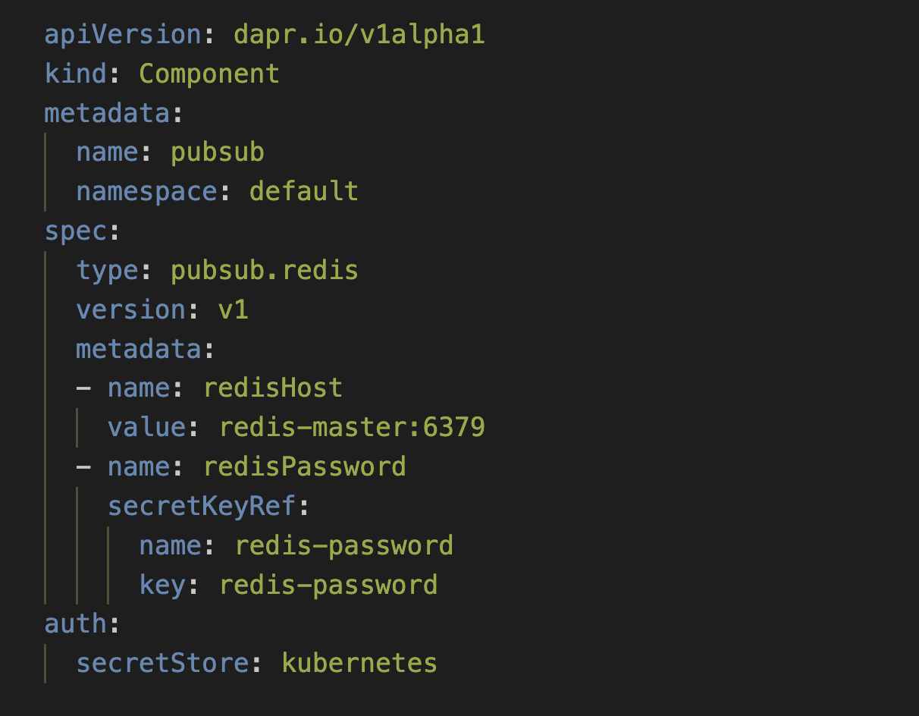


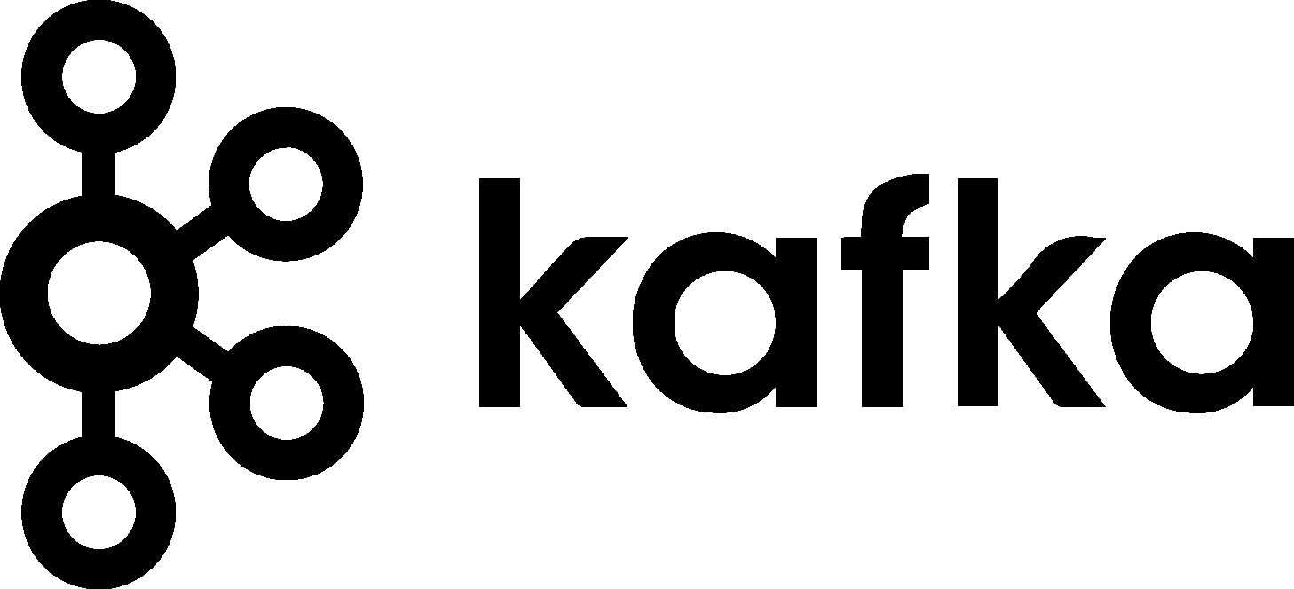
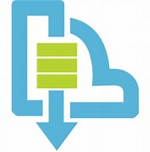

Publish and Subscribe
AWS SNS
CSharp
Subscriber
Redis
Cache
Python
Subscriber
React Form
Azure Service Bus
GCP Pub/
Sub
Notes:
The specific message broker used by your service is pluggable and configured as a Dapr pub/sub component file at runtime
Integration with 18 message brokers and queues. Open-source components written including integration redis, AWS SNS and gcp pubsub among others
This provides an abstraction onto your code and means that you do not have to import the Redis SDK into your code and call out to redis specifically but instead call out to the Dapr apis, removing the dependency from your service and making your service more portable and flexible to changes.
So, for instance, to publish on the Redis broker named “pubsub” I need a Dapr pubsub component named “pubsub”. The specification for this might look like the one on the right here And it has specific metadata values corresponding to the infrastructure connection details to the underlying broker. I have deployed this broker onto k8s but this could be living anywhere really – managed, in the cloud, on your machine etc.
And I could also swap this component file out for another file that corresponds to a different infrastructure piece. For instance, if I wanted to change to kafka, I would not need to make any code changes and just could swap the manifest to one of type “pubsub.kafka”

Slide 27
Resiliency in Pub/Sub
1
1
Outbound component resiliency policies can be applied to message publishing
Inbound component resiliency policies can be applied to subscriptions when delivering messages to subscribers
React Form
Python
Subscriber
Outbound
Pub/sub queue
Inbound
1
Pub/sub components have `retry` capabilities built-in. The policies are configured on a per-component basis.
Notes:
Built in resiliency with Dapr pub sub:
Can add configurable timeouts, retries and circuit breakers in pub sub calls as well to ensure that event driven calls are made to and from your message broker with confidence
Resiliency in Dapr pubsub can be on both the outbound side coming in from the publisher apps dapr sidecar well as the inbound side coming from the subscribers dapr sidecar to the subscribing app
Work on top of the existing resiliency features that exist with the underlying component, For example, Kafka, RabbitMQ and Redis

Slide 28
DEMO: Dapr state management and bindings
DEMO
Publish & Subscribe

Slide 29
Dapr hosting environments
Get started with dapr init
Easy setup with Docker images
Sets up placement, Zipkin, Redis
slim-init available without Docker
Run any application with Dapr sidecar using dapr run
Slim mode does executable deployment (no Docker images)
Self-deploy Dapr control plane per machine
Deploy Hashicorp Consul per machine
Run any application with Dapr sidecar using dapr run
Dapr Installer Package allows for offline/remote deployments with no network connectivity
Get started with dapr init –k
Integrated Dapr control plane
Deploys placement, operator, sentry, and injector pods
Automatically inject Dapr sidecar into all annotated pods
Upgrade with dapr upgrade or Helm
Virtual/Physical Machines
Self-hosted
Notes:
Three primary ways to host dapr today
90% of people we see run Dapr on Kubernetes in production

Slide 30






Dapr in self-hosted Docker mode
Dapr Components
dapr run myapp
State Stores
Launch application
Launch sidecar process
Set env variables
Actor
placement
PubSub
Brokers
Placement
Create mapping table of actor instances to pods
My App
Use components
Bindings
& Triggers
Zipkin
tracing
Zipkin
Send distributed tracing
Secret Stores
Redis
state store
Redis
Save and retrieve state
Publish and subscribe to messages
Local dev machine or virtual machine
Observability

Slide 31

Dapr on Kubernetes
Operator
Deploys and manages Dapr
Dapr Components
Pod
Pod
Pod
Pod
State Stores
Actor partition placement
Dapr
runtime
injector
Cert authority
and identity
Update component
changes
Placement
Injector
Sentry
Operator
Pub/Sub
Brokers
Create mapping table of actor instances to pods
Inject Dapr sidecar into annotated pods
Inject env variables
Manage mTLS between services
Assign spiffe identity
Manage component updates
Manage Kubernetes
service endpoints
Pod
Bindings
& Triggers
My App
Secret Stores
Readiness and Liveness probe on healthz API to determine Dapr health state
Kubelet
Use components
Observability
Any cloud or edge infrastructure

Slide 32







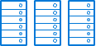
Dapr challenges in production
Keeping up with latest versions and security patches
Diagnosing application memory, error and latency issues
Performing regular certificate updates without incurring downtime
Making sense of over 150+ Dapr metrics
Tracking and applying production best practices
Rolling out applications to update Dapr versions
Understanding resource usage and controlling costs
Monitoring and managing multiple clusters with Dapr
Notes:
We at diagrid have worked with many enterprise customers who are using Dapr in production, have heard about the challenges people face running Dapr in produciton
- Dapr upgrades every three months etc

Slide 33
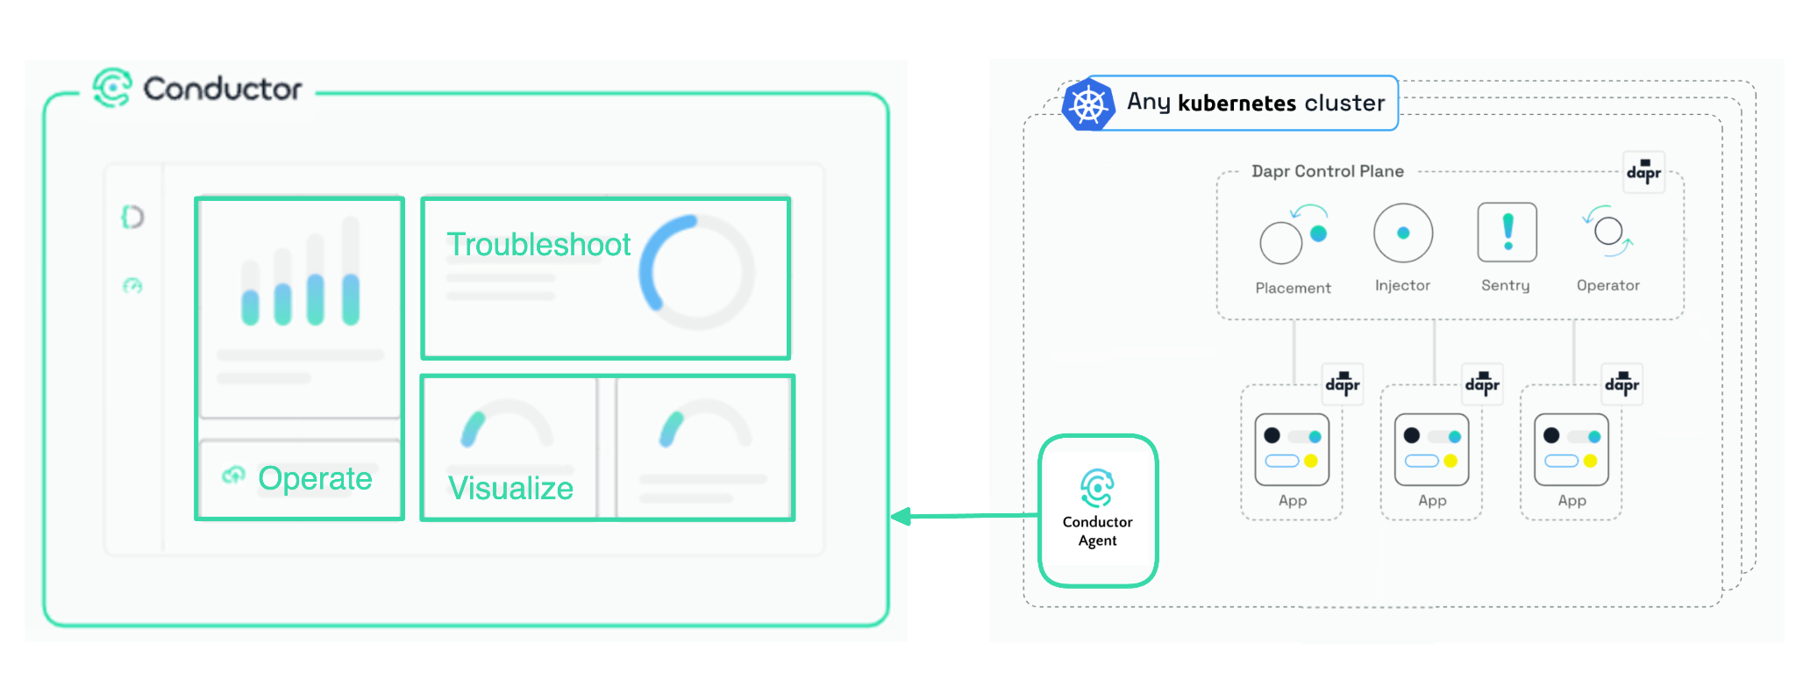
Operate Dapr on Kubernetes with Diagrid Conductor
Conductor manages Dapr on your Kubernetes cluster so you can focus on writing code
Notes:
Focused for operations folks or platform teams who are managing dapr on Kubernetes
-

Slide 34
DEMO: Dapr state management and bindings
DEMO
Dapr on Kubernetes with Diagrid Conductor
Notes:
Use https://docs.dapr.io/getting-started/quickstarts/serviceinvocation-quickstart/

Slide 35





Find out more
Get started at dapr.io
Code from today’s demo bit.ly/dapr-quickstarts
Discuss on Discord bit.ly/dapr-discord
Watch on YouTube bit.ly/dapr-youtube
Follow on Twitter @daprdev
Manage Dapr in production at diagrid.io

Slide 36


